Slide 1
PYTHON PROJECT
ON
BOOK MANAGEMENT SYSTEM
(BMS)
BY:-
TUSHAR SONKAR
GRITESH PRASAD KUMHAR
DWAIPAYAN DEB

Slide 2
SYSTEM REQUIREMENTS
Hardware Requirement:
Hardware Requirement:
Here is the recommended hardware requirement for this software to run efficiently.
1)Intel core i3 or higher processor
2)10 MB RAM
3)15 MB free hard disc space
4) SVGA monitors / Laptops
5) Printer (Optional)

Slide 3
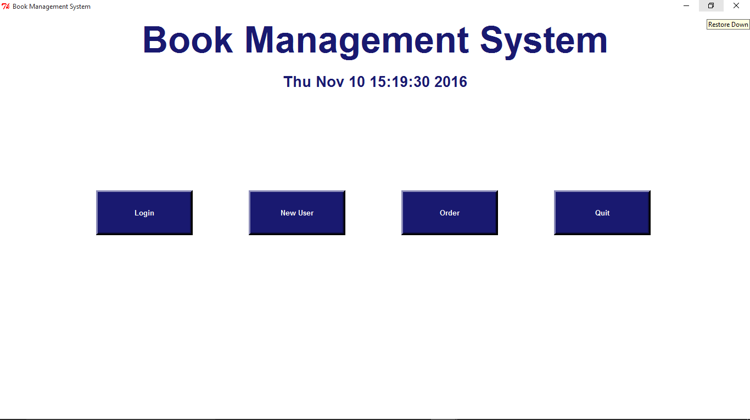
HOME PAGE

Slide 4
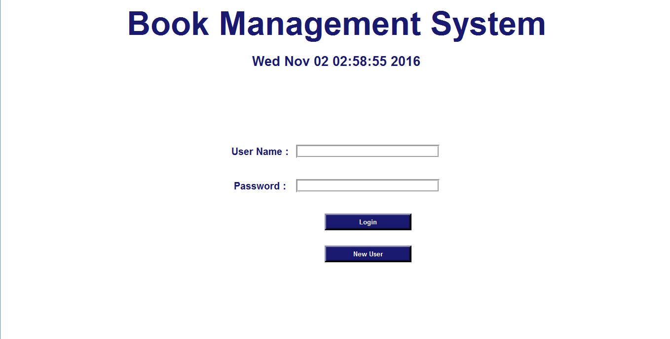
LOGIN PAGE

Slide 5
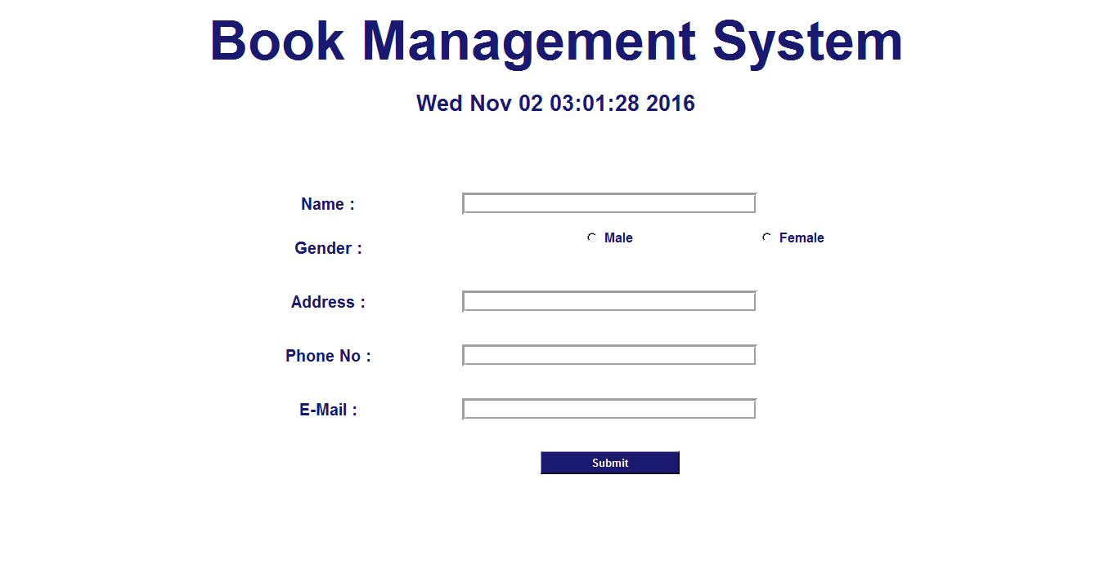
NEW USER PAGE

Slide 6
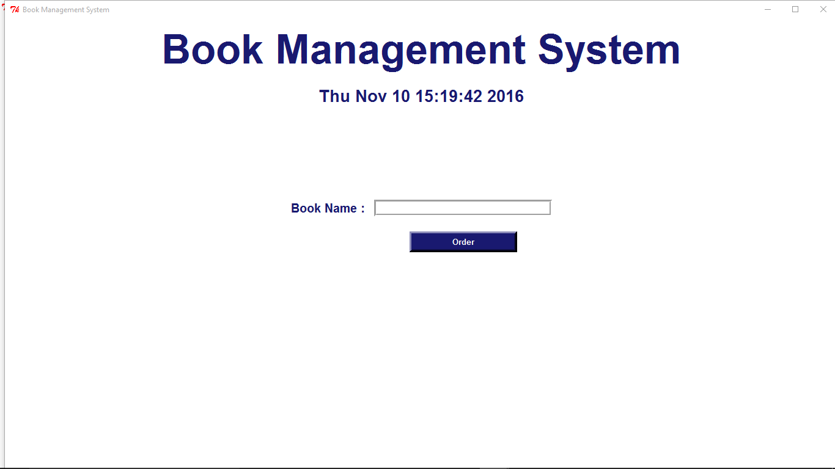
ORDER PAGE

Slide 7
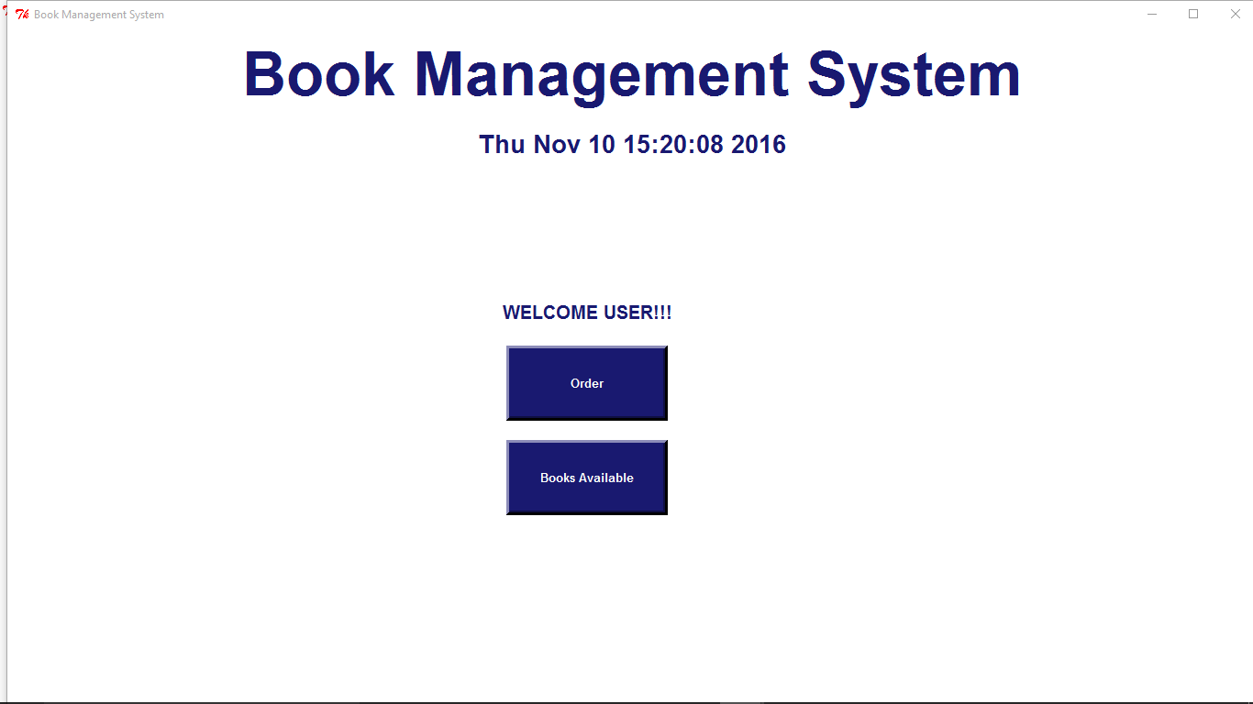
USER ACCOUNT PAGE

Slide 8
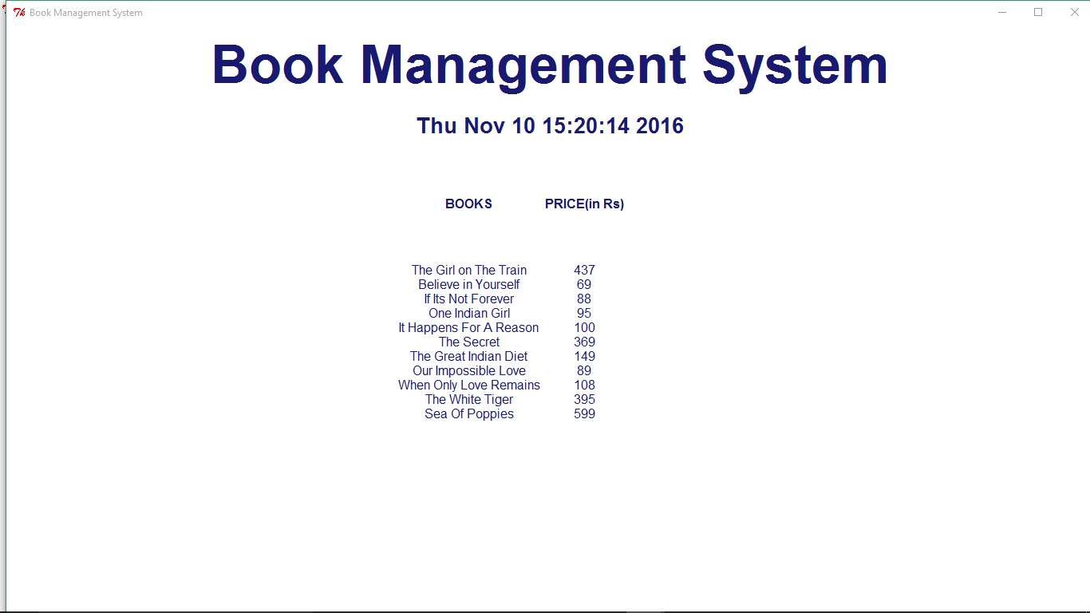
AVAILABLE BOOK MENU

Slide 9
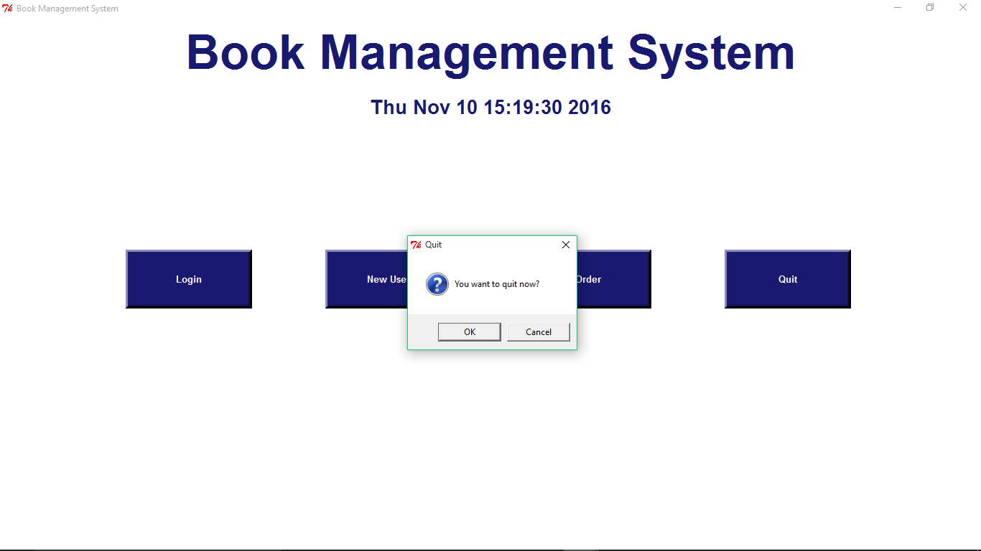
QUIT CONFIRMATION

Slide 10
GANTT CHART
Sr. No. | Task | Start | Finish | Duration (in Days)
1 | Understanding current system | 05-09-2016 | 12-09-2016 | 7
2 | Information gathering | 12-09-2016 | 19-09-2016 | 7
3 | Database design | 20-09-2016 | 26-09-2016 | 6
4 | Form design | 26-09-2016 | 05-10-2016 | 9
5 | Coding | 07-10-2016 | 20-10-2016 | 13
6 | Testing | 20-10-2016 | 22-10-2016 | 2
7 | Implementation | 23-10-2016 | 01-11-2016 | 9

Slide 11
THANK YOU

